Slide 1
Final Project Presentation GA Data Science 18
Theodore Love
4/20/2015

Slide 2

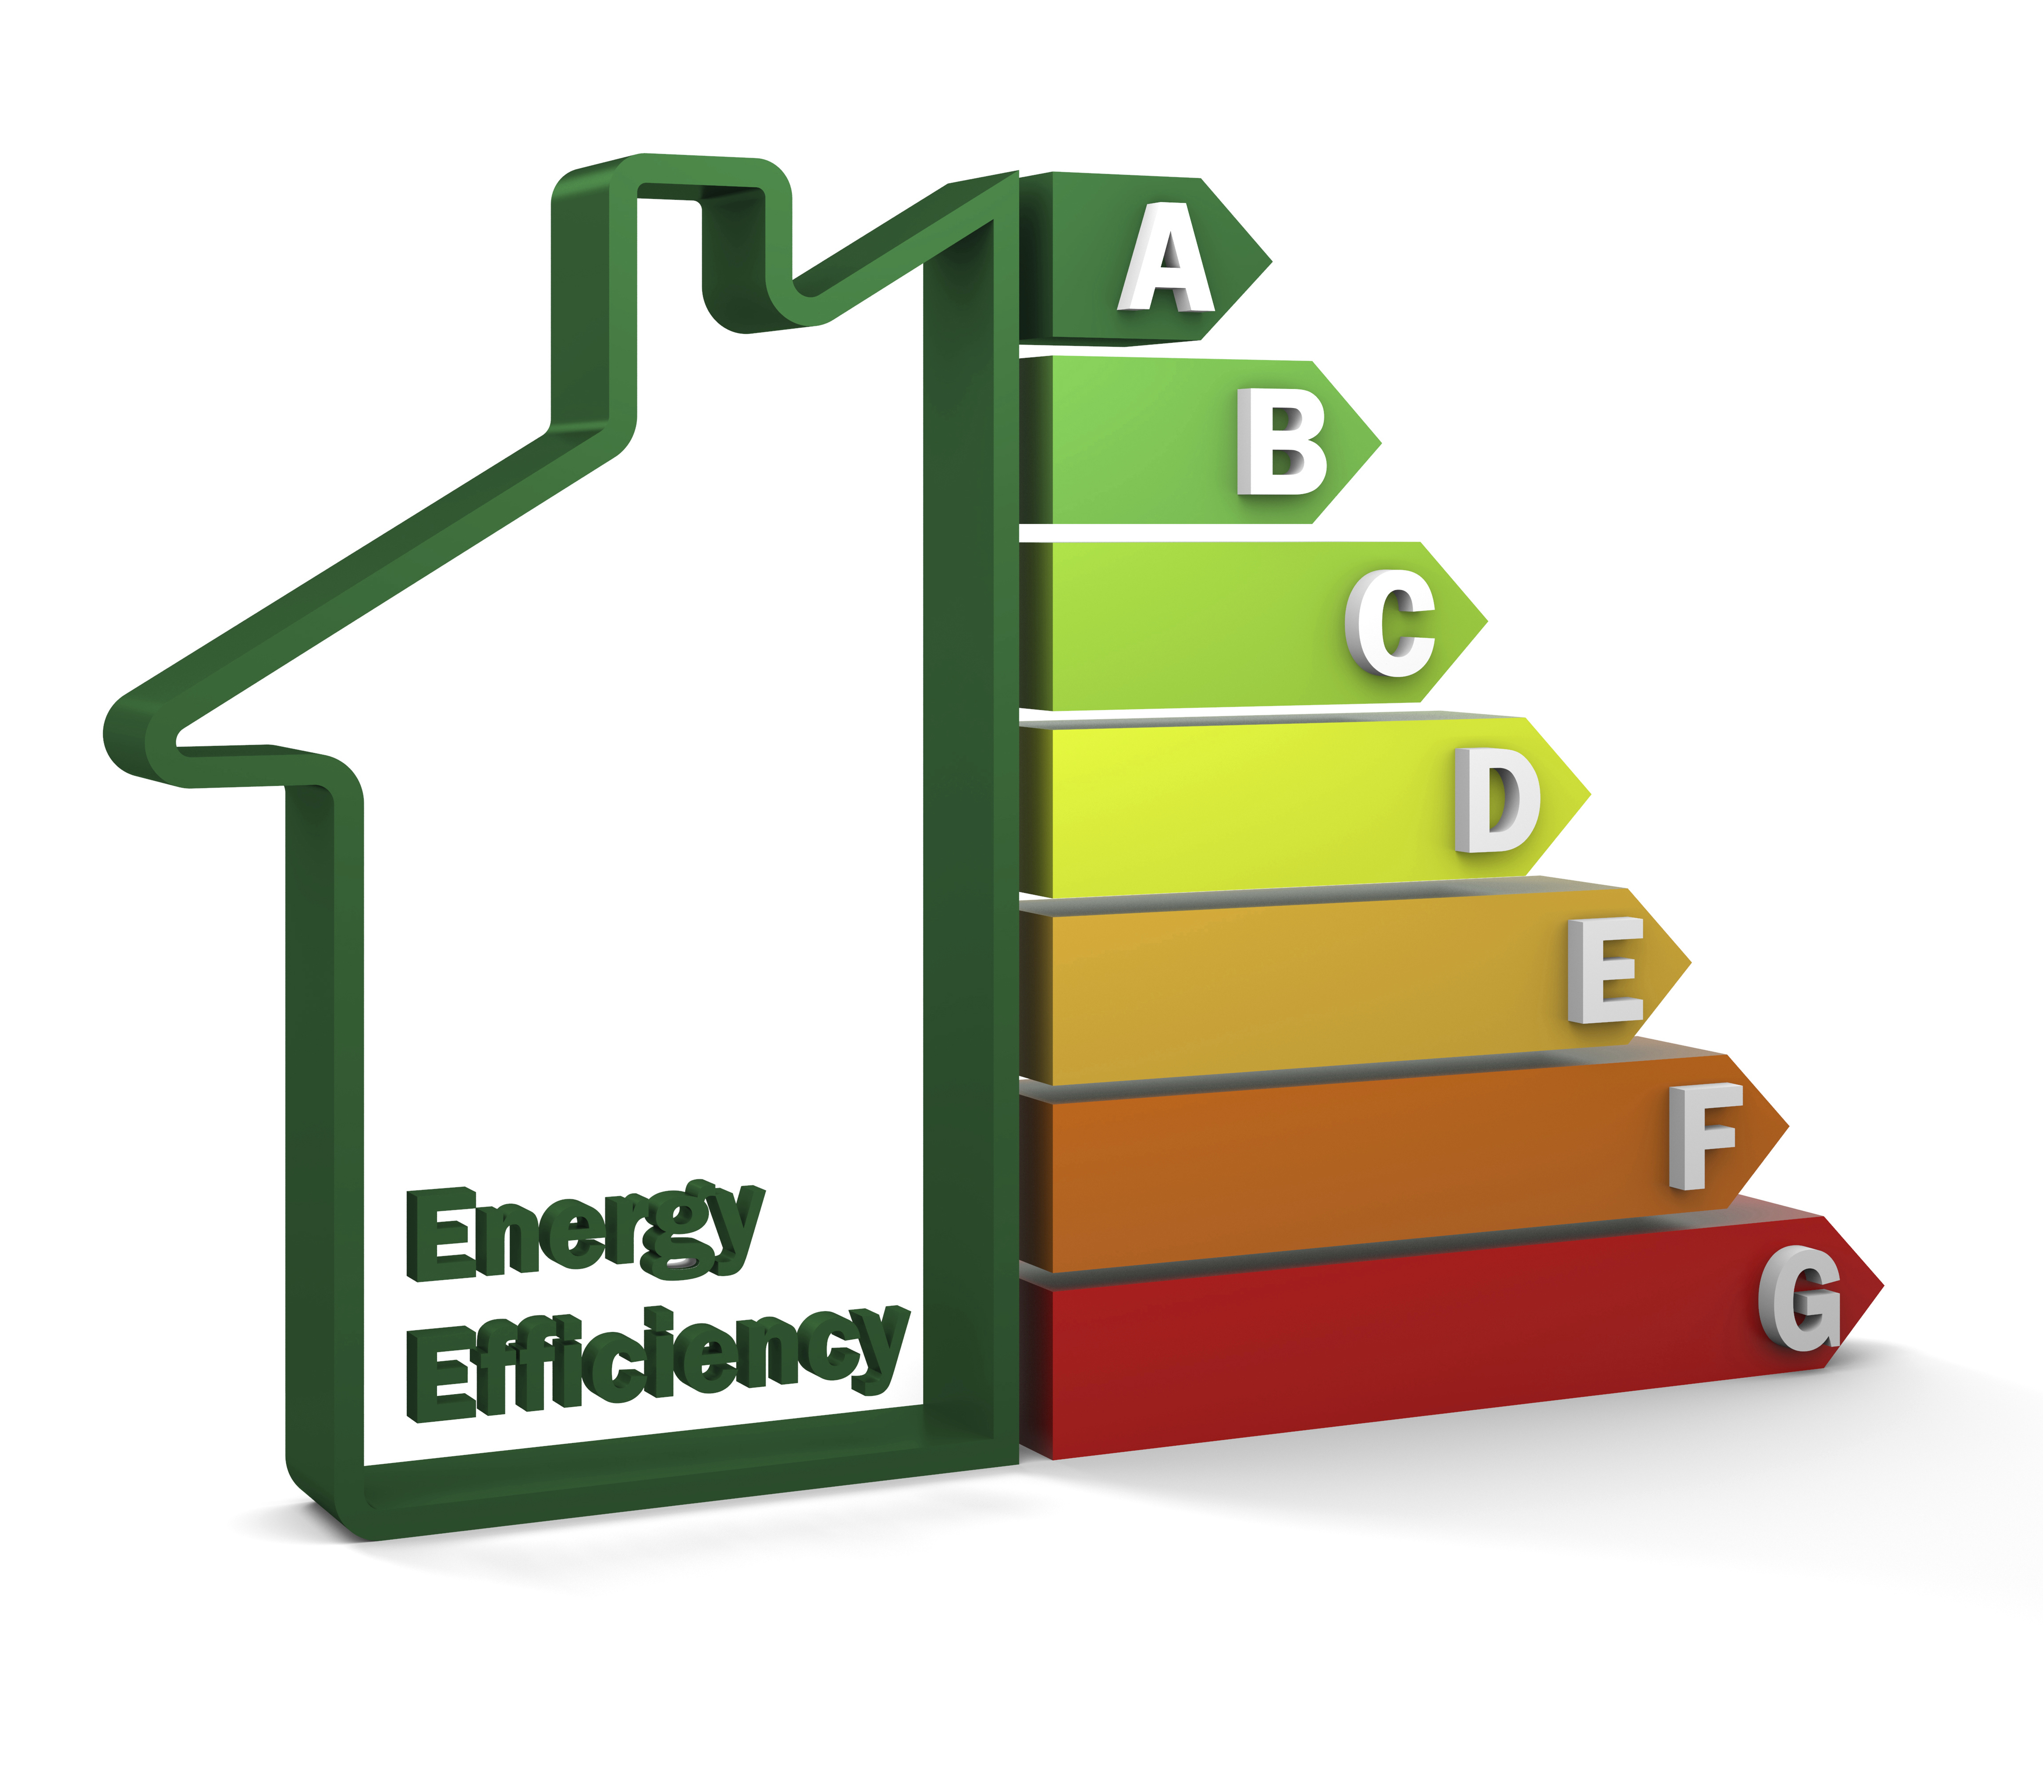

The Inspiration

Slide 3
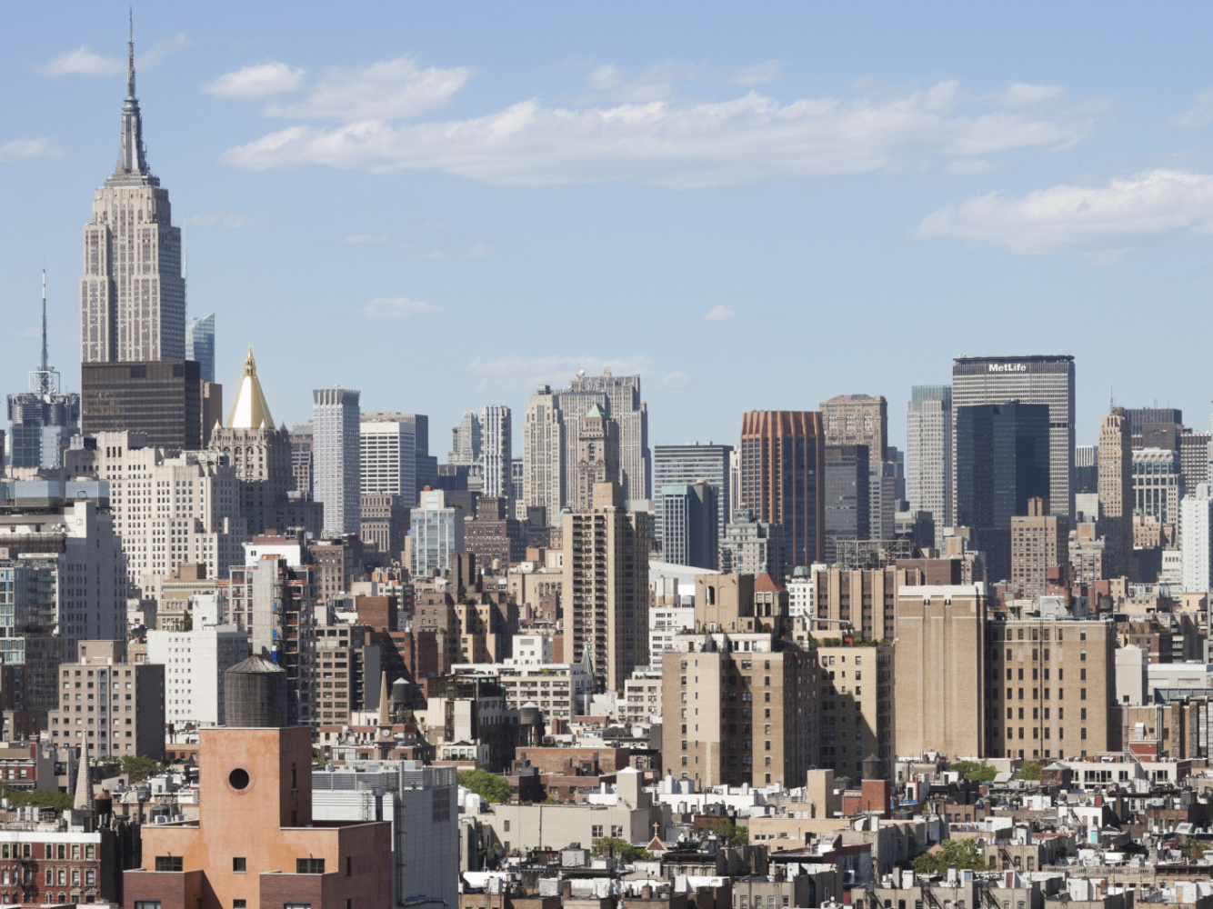
Local Law 84
B
B
A
C
D
D
C
A
B
A
D
D
B
B
A

Slide 4
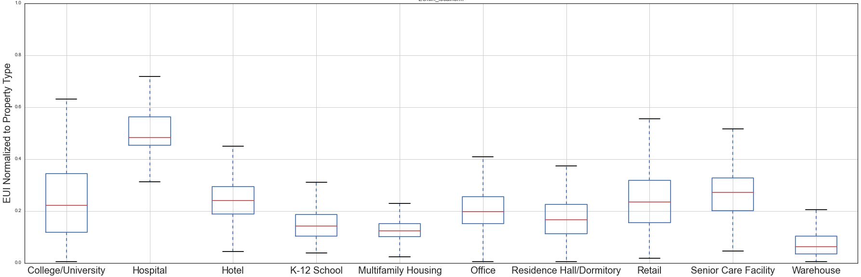
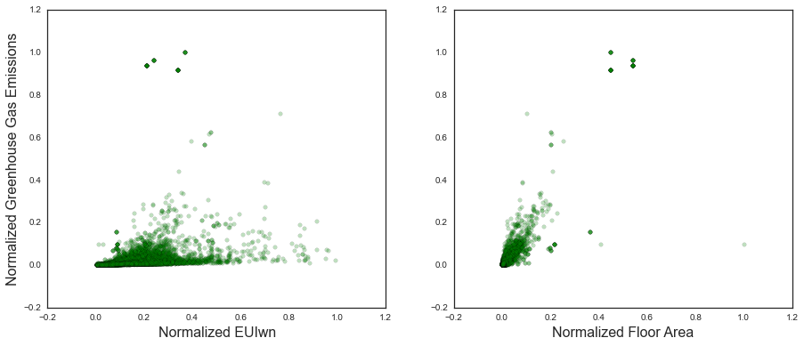
Initial Exploration

Slide 5
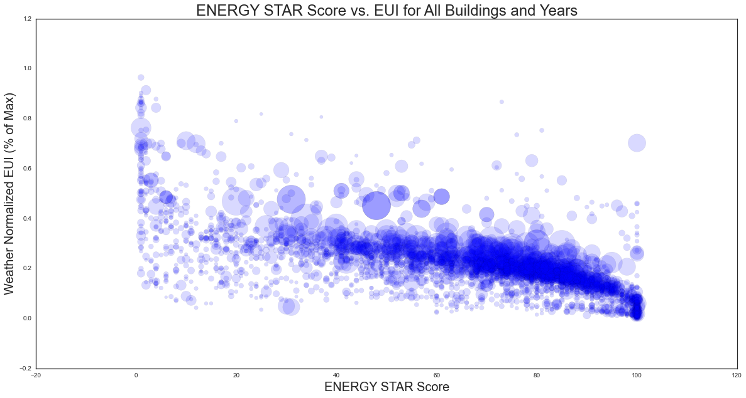
Existing Benchmarks

Slide 6
Going Further with New Data
PLUTO
~ 200 Features both categorical and continuous
Local Law 84
~ 15 Features
~ 14,000 Observations
Borough/Block/Lot (BBL)
Code Violations

Slide 7
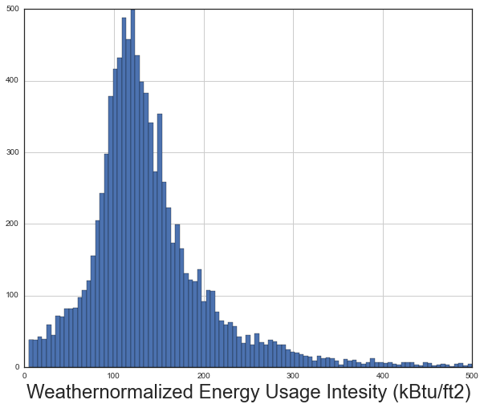
Let’s Try to Predict EUI

Slide 8
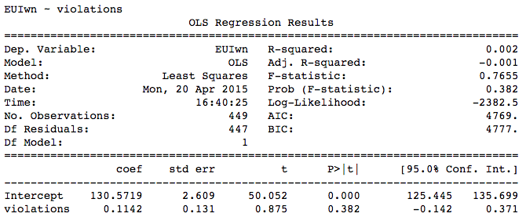
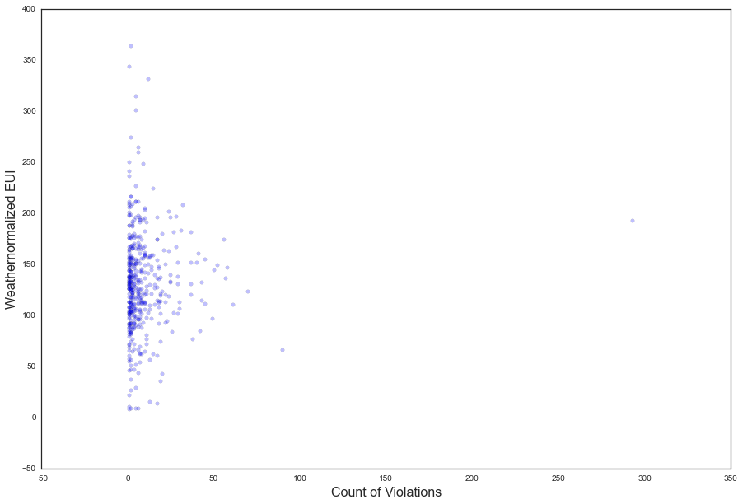
A Dead End
Do Housing Code Violations relate
to Energy Intensity?
No

Slide 9
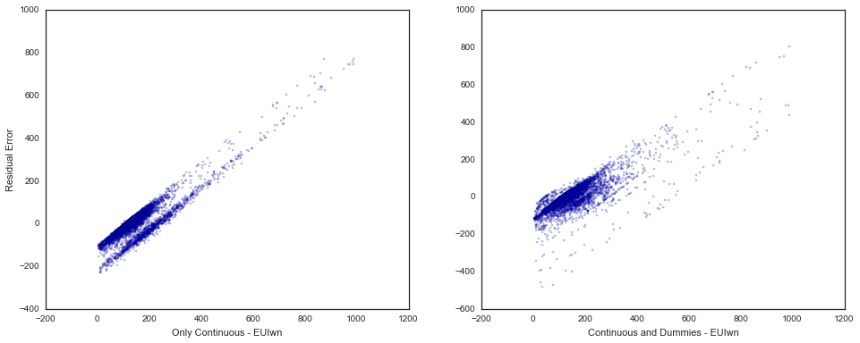
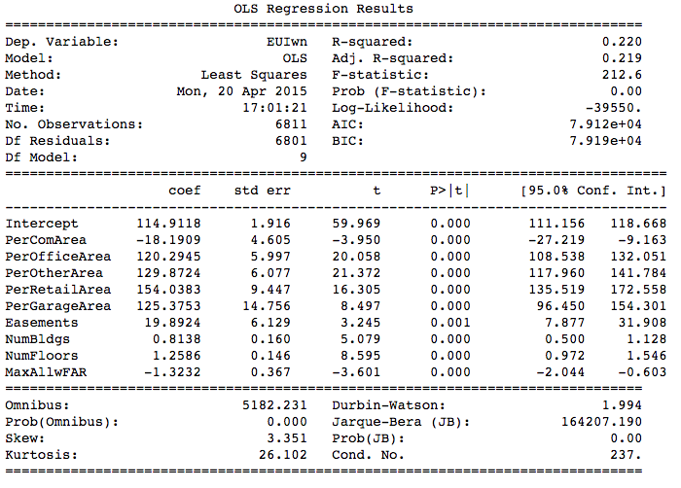
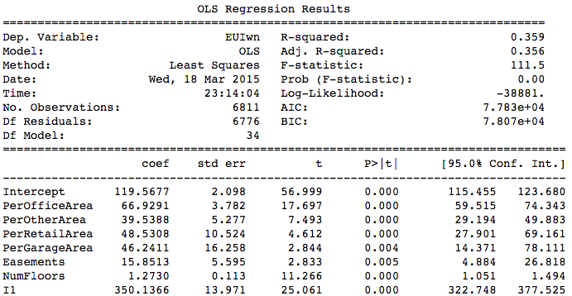
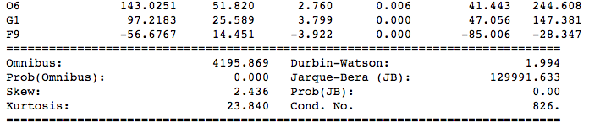
OLS with PLUTO
…

Slide 10
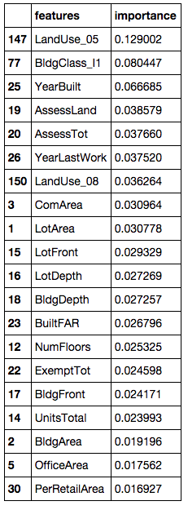
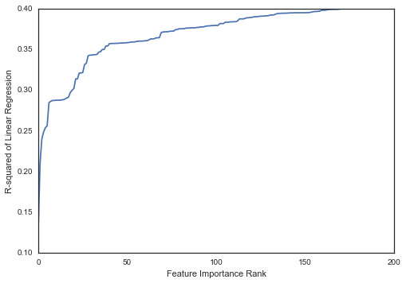
Tree Regressions with Full PLUTO Data
Hospitals and Health
Commercial & Office Buildings
Age of Building
Value of building/land
Public Facilities & Institutions
Size/usage percent of building
R² in OLS
As features added

Slide 11
Optimization of Decision Tree Regression
Cross-validation found over fitting issues across sub-samples even with low depths.
Random Forest Regression
R² from 0.23 to 0.29 with std dev ~0.03

Slide 12
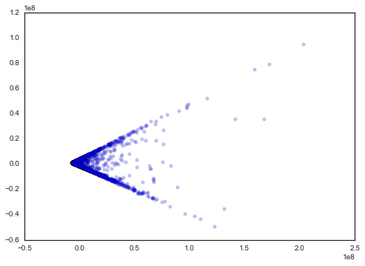
Quick PCA
PCA 2
12% of variance
PCA 1
83% of variance

Slide 13
Next Steps
Further examination of PCA
Exploration of residuals and classification of high users
See how regressions works on new data
Prepare white paper (BECC Conference)
theolove@gmail.com

